Slide 1
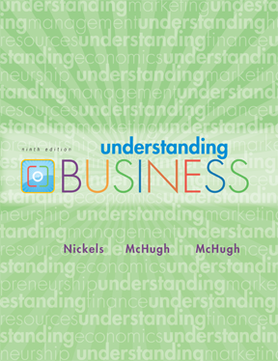
*
Chapter One
*
Taking Risks and Making Profits within the Dynamic Business Environment
McGraw-Hill/Irwin
Copyright © 2010 by The McGraw-Hill Companies, Inc. All rights reserved.

Slide 2
Learning Objectives
Entrepreneurship and Wealth Building
- Revenues, profits and Losses
- Matching Risk with Profit
-Standard of Living and quality of life
-Responding to the Various business stakeholders
-Using Business Principles in non-profit organizations
Entrepreneurship Versus Working for others
-Opportunities for entrepreneurs
-The Importance of Entrepreneurs to the creation of Wealth
The Business Environment

Slide 3
BUSINESS and ENTREPRENEURSHIP
*
Entrepreneurship and
Wealth Building
*
LG1
Business -- Any activity that seeks to provide goods and services to others while operating at a profit.
Entrepreneur -- A person who risks time and money to start and manage a business.
Successfully filling a market need means you could make money for yourself and provide jobs for others.
1-3

Slide 4


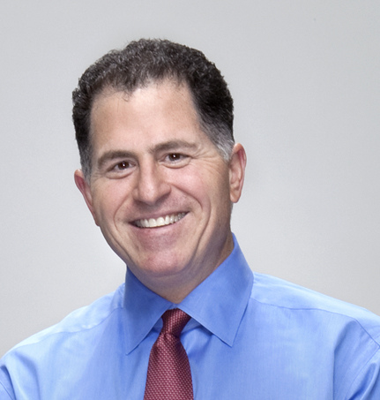
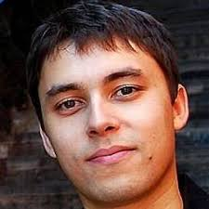
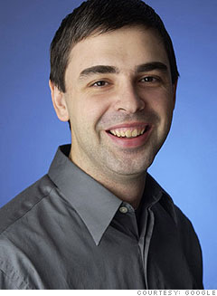


Famous Entrepreneur – worldwide
Bill Gates
Michael Dell
Steve Jobs
Jawed Karim
Larry Page
Reed Hastings
Jeff Bezos

Slide 5
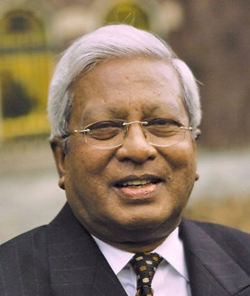
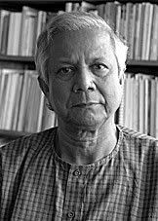


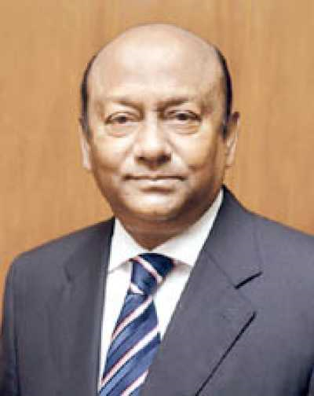

Famous Entrepreneurs – Bangladesh
Muhammad Yunus
Samson H Chowdhury
Sir Fazle Hasan Abed
M Anis Ud Dowla
Latifur Rahman
Hussain M Elius

Slide 6

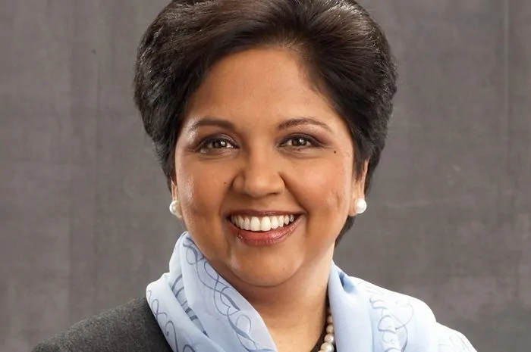

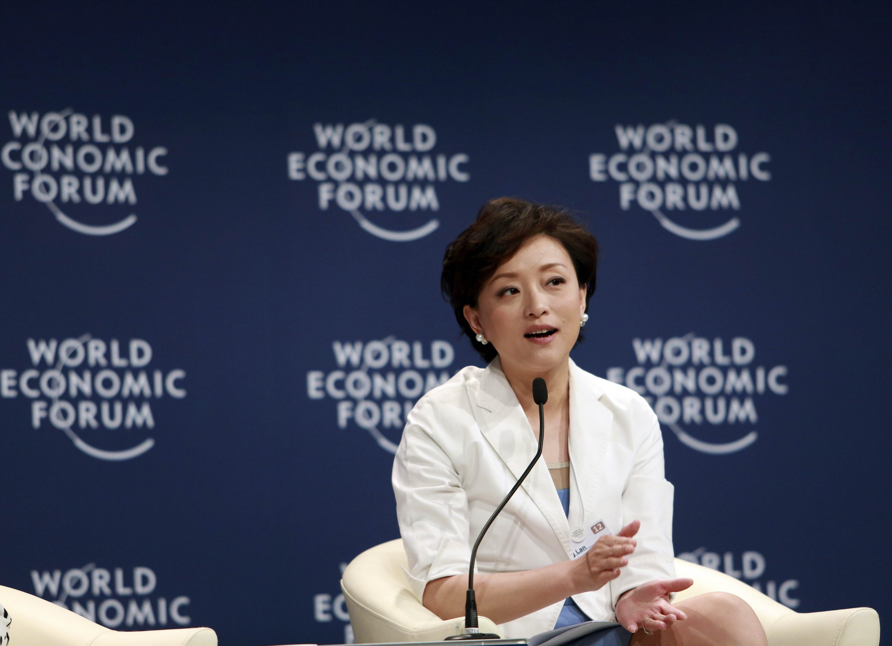

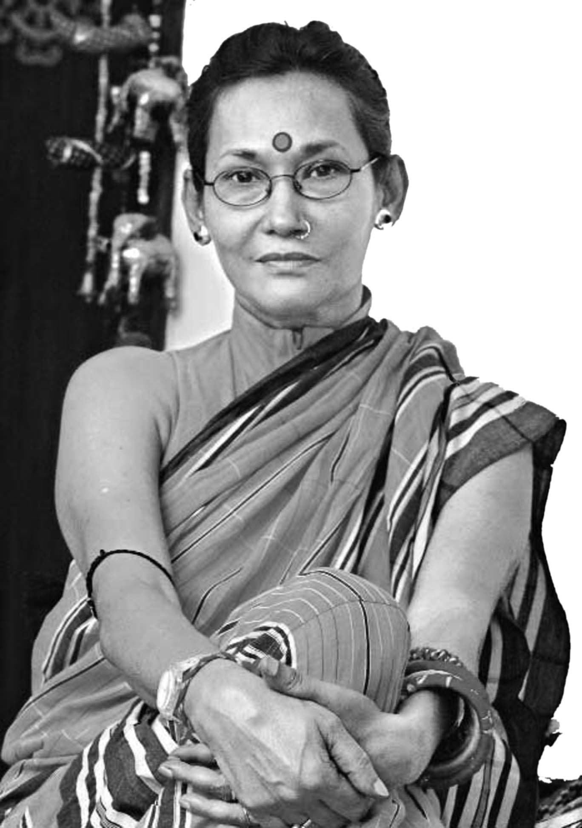
Famous Entrepreneur – worldwide
Oprah Winfrey
Indra Nooyi
Ekta Kapoor
Yang Lan
Bibi Rusell
Sonia Bashir Kabir

Slide 7
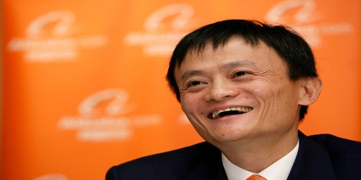

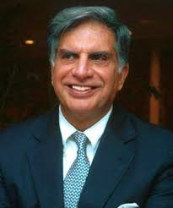

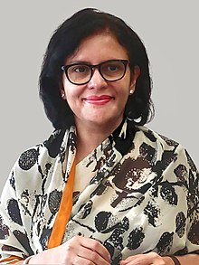

Mini Activity 1: Who are they? What they are famous for?
Mark Zuckerberg
Jack Ma
Ratan Tata
Rubaba Dowla
Rubana Huq
Ayman Sadiq

Slide 8

REVENUE, PROFIT AND LOSS
*
Revenues, Profits and Losses
*
Revenue -- The total amount of money a business takes in during a given period by selling goods and services.
Profit -- The amount of money a business earns above and beyond what it spends for salaries and other expenses.
Loss -- Occurs when a business’ expenses are more than its revenues.
Risk – The chance an entrepreneur takes of losing time & money on a business that may not prove profitable.
LG1
1-8

Slide 9

QUALITY of LIFE
*
Businesses Add to the Standard of Living and Quality of Life
*
The general well-being of a society in terms of its political freedom, natural environment, education, healthcare, safety, amount of leisure and rewards that add to personal satisfaction.
LG1
1-9

Slide 10
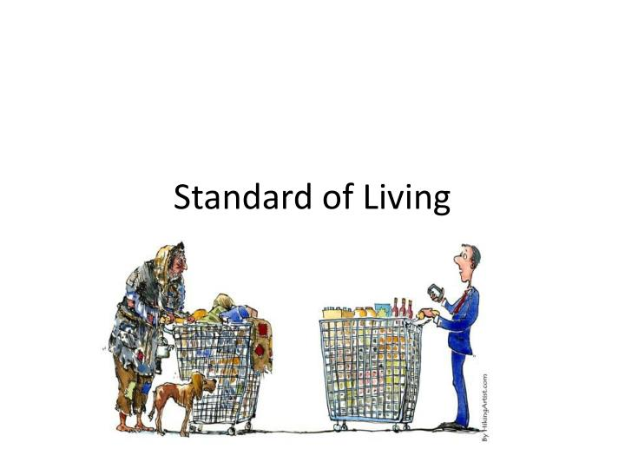
STANDARD OF LIVING
*
Businesses Add to the Standard of Living and Quality of Life
*
The amount of goods & services people can buy with the money they have.
LG1
1-10

Slide 11
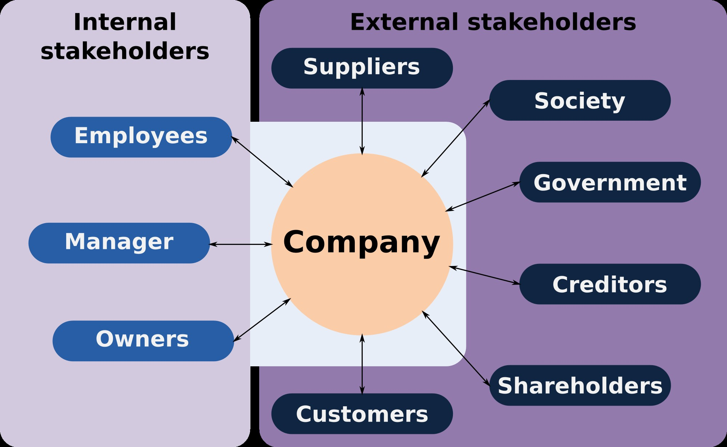
Stakeholders
*
Responding to Various Stakeholders
*
LG1
Any individual or group who can affect or are affected by the achievement of a firm’s objectives
Stakeholders- customers, employees, stockholders, suppliers, government etc.
1-11

Slide 12

Outsourcing
*
Businesses Add to the Standard of Living and Quality of Life
*
LG1
Contracting with other companies to do some or all of the functions of a firm.
1-12

Slide 13
Responding to various business Stakeholders
*
Businesses Add to the Standard of Living and Quality of Life
*
LG1
Non-profit organizations- is a business that has been granted tax-exempted because it furthers a social cause and provides a public benefits. Ex-school, college, hospital, charity, RAB, police force etc.
Social Entrepreneurs- People who address business principles to manage not-for-profits and help address social issues. eg-Mohammad Yunus.
They differ based on how they attain money. Non-profits acquire money through fundraising efforts whereas social enterprises operate like a for-profit business by selling a product or service to the public and acquire funds through sales.
1-13

Slide 14
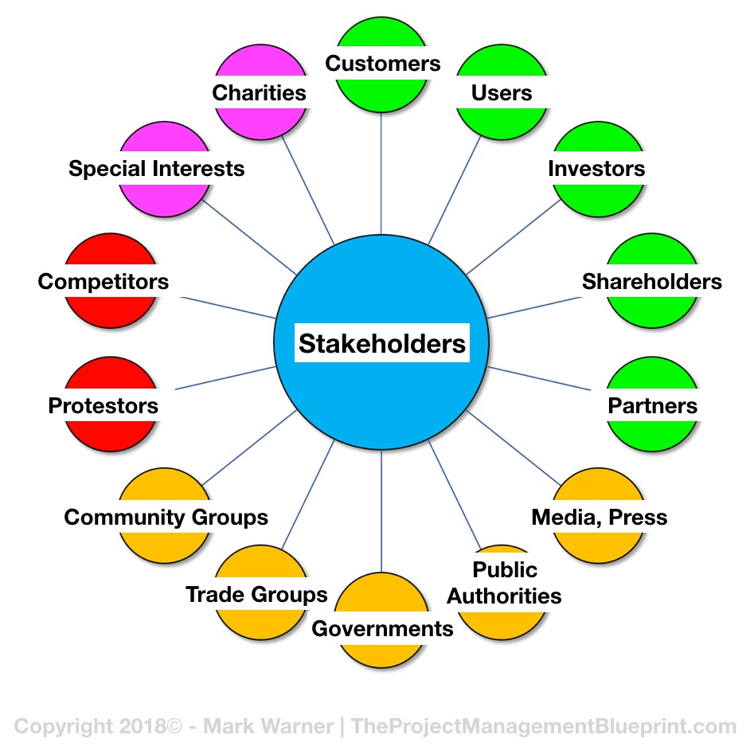
Mini Activity 2: Find the External & Internal Stakeholders
*
Businesses Add to the Standard of Living and Quality of Life
*
LG1
1-14

Slide 15
Entrepreneurship VS Working for others
*
Businesses Add to the Standard of Living and Quality of Life
*
Entrepreneurship
Own the business
Freedom to succeed as well as freedom to fail
Do not receive any benefits such as paid vacation time, day care, a company car or health insurance.
Working for others
Somebody else assumes entrepreneurial risk
Provides with benefits such as paid vacation and health insurance.
LG1
1-15

Slide 16

Class Assessment
1. Write Down 10 stakeholders of BRAC University
2. Find out the 2 more benefits of being an entrepreneur which are not mentioned in the slide.

